Slide 1
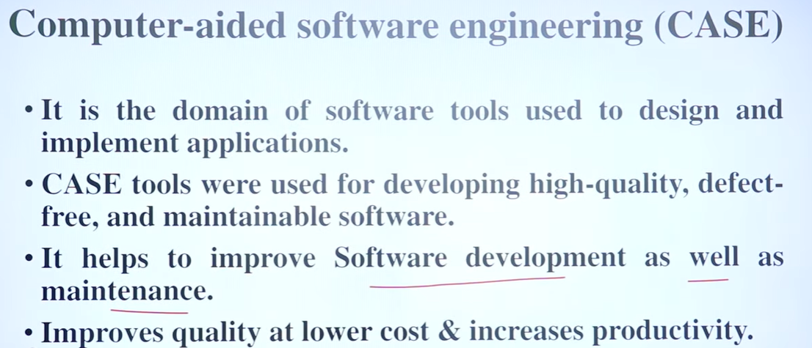

Slide 2
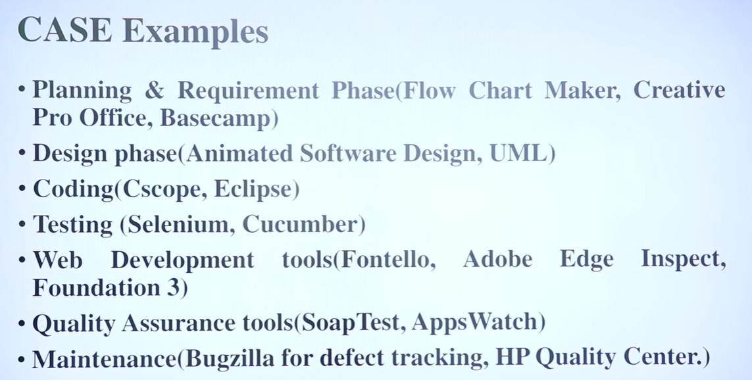

Slide 3
Computer Aided Software Engineering (CASE)
CASE tools help in
software development
and maintenance.
CASE is a much talked about topic in software industries.

Slide 4
CASE and Its Scope
CASE tool is a generic term:
  denotes any form of automated support for software engineering.
In a more restrictive sense:
  a CASE tool automates some software development activity.

Slide 5
CASE and Its Scope
Some CASE tools assist in phase-related tasks:
  specification, structured analysis, design, coding, testing, etc.
Other tools help non-phase activities:
  project management and configuration management.

Slide 6
Objectives of CASE
To increase productivity
To help produce better quality software at lower cost.

Slide 7
CASE Environment
Although individual CASE tools are useful:
  true power of a tool set can be realized only when:
    all CASE tools are integrated together.

Slide 8
CASE Environment
Tools covering different stages of life cycle share information (data):
  they should integrate through some central repository (store)
  consistent view of development information.

Slide 9
CASE Environment
The central repository is the data dictionary:
  contains definition of all composite and elementary data items.
  through this repository all CASE tools share information.

Slide 10
Programming Environment
A CASE environment helps:
  automate step-by-step methodologies.
In contrast to CASE environment:
  a programming environment denotes tools supporting coding phase alone.

Slide 11
Schematic representation of architecture of CASE environment
Consistency-
checker
Testing
Central
Repository
Project
Management
Structured
Design
Coding
Support
Structured
Analysis
Document
Generation
Configuration
Management

Slide 12
Benefits of CASE
A key benefit of using CASE environment:
  cost saving through all developmental phases.
Studies carried out to measure the impact of CASE usage:
  cost saving between 30% to 40%.

Slide 13
Benefits of CASE
Use of CASE tools leads to improvements in quality:
  becomes easy to iterate through different software development phases.
  chances of human error is reduced.
  CASE tools help produce higher quality and consistent documents.

Slide 14
Benefits of CASE
Data relating to a software product are maintained in a central repository:
  redundancy in the stored data is reduced.
  chances of inconsistent documentation is reduced.

Slide 15
Benefits of CASE
CASE tools take drudgery out from software engineers’ work:
  engineers need not manually check balancing of the DFDs
  easily draw diagrams and produce documentation, etc.

Slide 16
Benefits of CASE
CASE tools lead to cost saving in software maintenance effort:
  traceability and consistency checks,
  systematic information capture during various development phases.

Slide 17
Benefits of CASE
Introduction of a CASE environment:
  impacts the style of working of engineers.
  makes them oriented towards structured and orderly approach.

Slide 18
Prototyping Support
Prototyping CASE tool:
  often used in graphical user interface (GUI) development,
  supports creating a GUI using a graphics editor.

Slide 19
Prototyping Support
The user should be allowed to define:
  data entry forms, menus and controls.
It should integrate with the data dictionary of a CASE environment.

Slide 20
Structured Analysis and Design
A CASE tool should:
  support some standard structured analysis and design technique.
  support easy creation of analysis and design diagrams.
  should provide easy navigation through different levels of design and analysis diagrams.

Slide 21
Structured Analysis and Design
The tool must support completeness and consistency checking.
The tool should disallow inconsistent operations:
  but, it is difficult to implement such a feature.

Slide 22
Code Generation
As far as code generation is concerned:
  expectations from a CASE tool is low.
The CASE tool should support:
  generation of module skeletons in one or more popular languages.
  Another reasonable requirement is traceability from source code to design.

Slide 23
Code Generation
It should automatically generate header information:
  copyright messages,
  brief description of the module,
  author name and date of creation, etc.

Slide 24
Code Generation
The tool should generate data records or structures automatically:
  using data dictionary definitions.
  It should generate database tables for relational database management systems.

Slide 25
Code Generation
The tool should generate code for user interface from the prototype:
  for X window and MS window based applications.

Slide 26
Testing Support
Static and dynamic program analysis of programs.
It should generate test reports in ASCII format:
  which can be directly imported into the test plan document.

Slide 27
Desirable Features
The tool should work satisfactorily
  when many users work simultaneously.
The tool should support windowing interface:
  Enable the users to see more than one diagram at a time.
  Facilitate navigation and switching from one part to the other.

Slide 28
Documentation Support
The deliverable documents:
  should be able to incorporate text and diagrams from the central repository.
  help in producing up-to-date documentation.

Slide 29
Desirable Features
The CASE tool should integrate
  with commercially available desk-top publishing packages.
It should be possible to export text, graphics, tables, data dictionary reports:
  to DTP packages in standard formats such as PostScript.

Slide 30
Project Management
It should support collecting, storing, and analyzing information on the software project's progress:
  such as the estimated task duration,
  scheduled and actual task start, completion date, dates and results of the reviews, etc.

Slide 31
External Interface
The tool should allow exchange of information for reusability of design.
  The information exported by the tool should preferably be in ASCII format.
The data dictionary should provide
  a programming interface to access information.

Slide 32
Reverse Engineering Support
The tool should support:
  generating structure chart, DFD, and data dictionary from source code.
  should populate the data dictionary from source code.

Slide 33
Data Dictionary Interface
Data dictionary interface should provide
  viewing and updating the data definitions.
  print facility to obtain hard copy of the viewed screens.
  analysis reports like cross-referencing, impact analysis, etc.
  it should support a query language.

Slide 34
Tutorial and Help
Successful use of CASE tools:
  depends on the users’ capability to effectively use all supported features.
For the first time users:
  a computer animated tutorial is very important.

Slide 35
Tutorial and Help
The tutorial should not be limited to teaching the user interface part only:
  The tutorial should logically classify and cover all techniques and facilities.
  The tutorial should be supported by proper documentation and animation.

Slide 36
Towards Next Generation CASE Tool
An important feature of next generation CASE tools:
  be able to support any methodology.
Necessity of a CASE administrator for every organization:
  who would tailor the CASE environment to a particular methodology.

Slide 37
Intelligent Diagramming Support
Future CASE tools would
  aesthetically and automatically lay out the diagrams.

Slide 38
Towards Next Generation CASE Tool
The user should be allowed to:
  integrate many different tools into one environment.
  It is highly unlikely that any one vendor will be able to deliver a total solution.

Slide 39
Towards Next Generation CASE Tool
A preferred tool would support tune up:
  user would act as a system integrator.
  This is possible only if some data dictionary standard emerges.

Slide 40
Customization Support
The user should be allowed to define new types of objects and connections.
This facility may be used to build some special methodologies.
Ideally it should be possible to specify the rules of a methodology to a rule engine:
  for carrying out the necessary consistency checks.

